Slide 1
17 February - Conference "Critical Issues for AU-EU Collaboration on Health and Science"
Capacity Development for Peace-Building in Africa as a precondition for Collaboration
Dr Reginald Nalugala, Tangaza University College, Nairobi
Plan: Capacity development, peace building in Africa and why collaboration is important

Slide 2
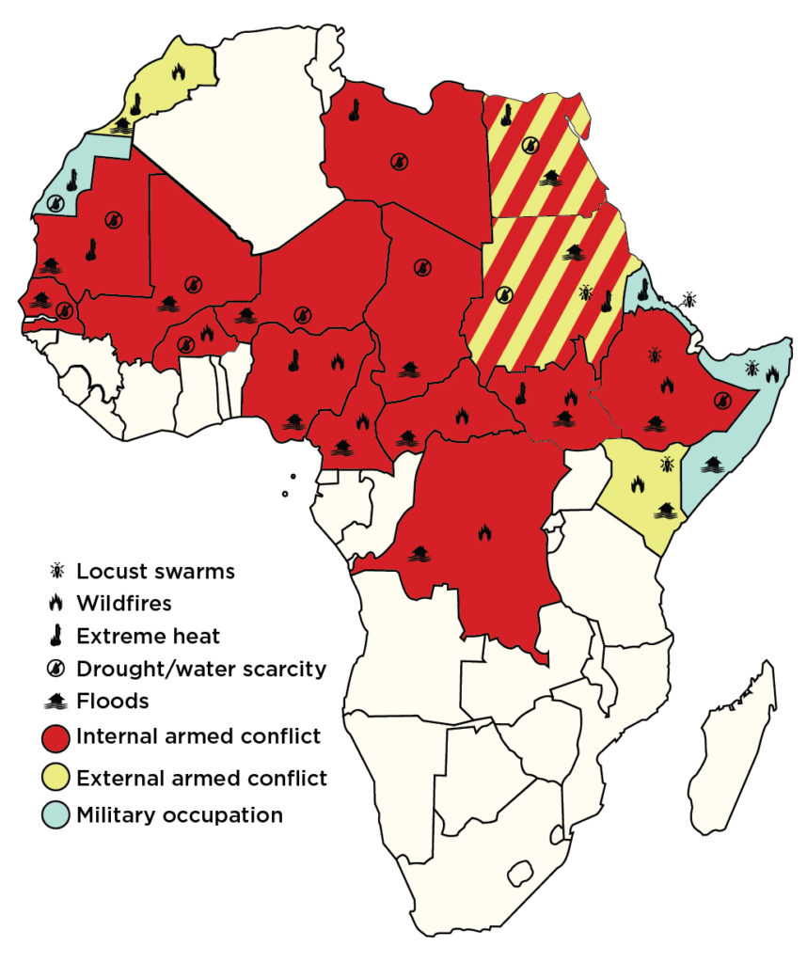
Situational review: Climate change factors and armed conflict 2020
The continent of Africa was almost succeeding in putting off ambers of conflict fires which devastated the continent over sixty years, then came the covid19 pandemic in 2020. Before covid19 The Ebola endemic had been well managed and contained by WHO. On peacebuilding, Kenya had led the way with the famous ‘handshake’ in 2018 between the sitting president and the opposition to show the world that peace building requires great humility and humbles because the nation is bigger than individual egos.

Slide 3
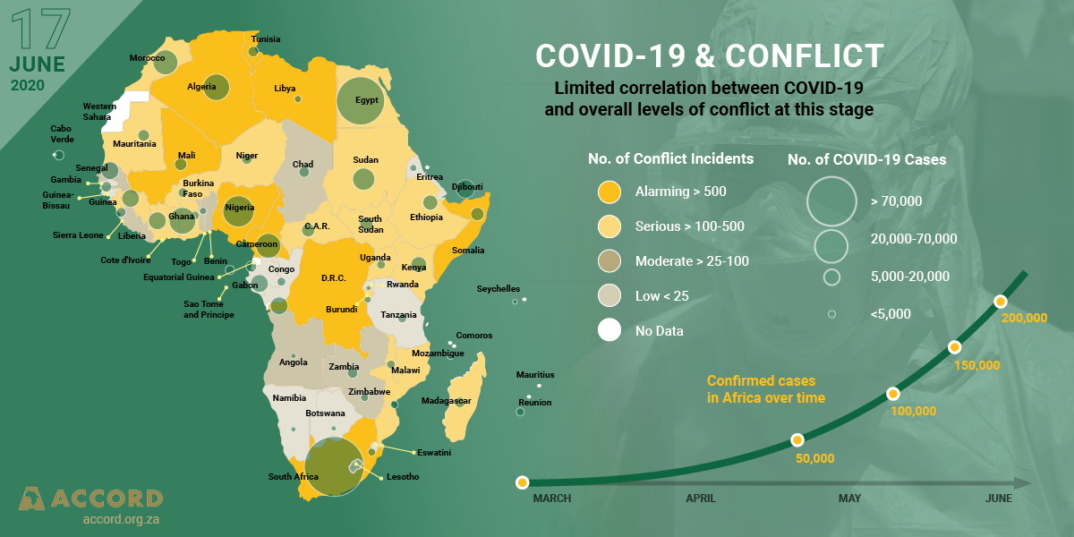

Slide 4
The issue at hand:
Anna Marriot, Oxfam’s Health Policy Manager, while speaking on BBC same time (November 2021), criticized vaccine producers for boasting to have the experience and expertise of vaccine development, yet by then only 35 of Africa was fully vaccinated ( 10% by January 2022).
Pfizer, BioNTech and Moderna were going to share pre-tax profits of $34 billion by end of 2021, none of which is shared among poor countries of the South.
Reaction
This prompted academics across Africa and Europe to by demand worldwide action for a broad vaccination campaign in Africa by writing to the World Health Organization and the European Union.
Reply
Director-General of the World Health Organization, Dr. Tedros Adhanom Ghebreyesus appreciated the call and added that 'vaccine nationalism threatens to prolong the pandemic'.

Slide 5
Peace building in Africa has been affected by covid-19 pandemic. COVID-19 pandemic has changed the dynamics of human security globally.
The weak socio-economic outlook for states and citizens in Africa has been further exacerbated by negative impacts of the pandemic.
COVID-19 has exposed disparities in security indices, known as the root causes of conflicts in Africa more obvious, and also exposed how health issues are intricately interwoven with peace and security.
The UN Commission on Peacebuilding in the Great lakes region underlined the intersection between covid19 pandemic and the disruption of economic activities in key sectors, such as health, education, transport, trade and tourism.
Because the countries capacities could not cope, peace and security challenges were ignored.

Slide 6
Peacebuilders have recognised the intersection between peace and security, on the one hand, and the health pandemic on the other, and are responding in innovative ways to ameliorate the multiplier impacts in their communities.
Those already mobilising adaptive measures, in particular, are in two categories: one group is responding to the pandemic as a threat to peace and security while the other is responding directly to the pandemic as a health issue.
Irrespective of the categories countries in Africa , (Horn of Africa), the call is for collaboration among all stakeholders and the networks institutions, local and international organizations for resilience and innovations for the common good of the affected citizens.
Adds value to Africa’s peace and security efforts now and beyond the covid19 pandemic.

Slide 7
Q. What must we do then?
Capacity development, addressing peace building within each country, promoting the principles and values that uplift each person irrespective of ethnicity, clan, region, or political affiliation: ubuntu or utu does not discriminate.
International collaboration means stopping Politicization of healthcare and covid19
Actors- FBOS, National integration and cohesion commission in Kenya,
Region: All Africa Conference of Churches, with their partners across the globe, ( Tangaza University , EEPA, American Friends, recognizing cohesion and peaceful coexistence and sharing in the common goods like vaccines to all citizens.
Through AMECEA Countries all concerned for peace and mobilizing adaptive measures for peaceful solutions and amicable handshakes for development, for better delivery of services.
West-Europe-Africa peace initiatives, local community actors -across border initiatives call for collaboration from the international community to build capacity that understands its own context and also recognizes the international law. Geneva conventions for rights observances etc.

Slide 8
President of Kenya and UN Security Council initiatives recognize the nexus between peace building and health care delivery as a right for all citizens. It means even prisoners, prisoners of war, those in captivity deserve the same rights as free people, whether passing through as refugees, migrants or stranded passers-by. RESIDENT OF KENYA: leading IGADD and UN Security Council for warring groups to shake hands. If it has worked in Kenya, it can work anywhere. But the right capacity of leaders immersed in humility and humbles are key.

Slide 9
Conclusion
We recognise the intersection between peace and security, on the one hand, and the health pandemic on the other. But capacity development has been hampered by conflict due to poor leadership. It calls for innovative ways to ameliorate the multiplier impacts in their communities.
Therefore, capacity development for peace building in Africa should be taken as a precondition for collaboration among nations, across continents and with donors.
Key references
https://igad.int/conflioct mediation
Golda Keng, Charles Ukeje and Rhuks Ako (2021).COVID-19 and Peacebuilding in Africa: Youth, Resilience and Innovation Options. Published by ACCORD, ZA (africaportal.org)and https://www.accord.org.za/
https://www.un.org/peacebuilding/sites/www.un.org.peacebuilding/files/documents/pbc-glr-press_statement-
UN Peacebuilding Commission | ReliefWeb
https://www.un.org/peacebuilding/commission
COVID-19 vaccines | WHO | Regional Office for Africa

